Slide 1
Topics to be Covered:
Java Package
How to create package in Java
How to compile and execute package
How to access package
Role of Access Modifiers in Package

Slide 2
Java Packages

Slide 3
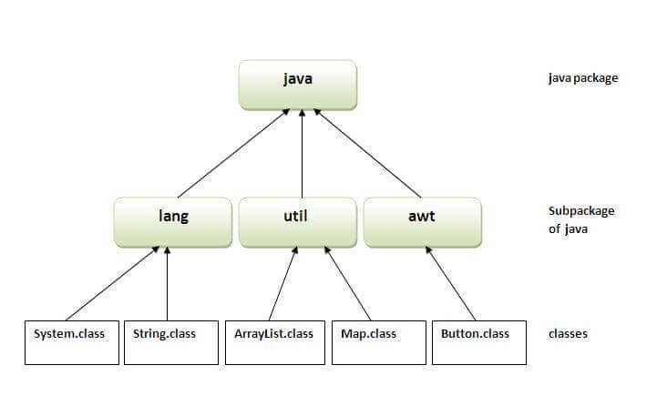
Java Package
A java package is a group of classes, interfaces and sub-packages.
Package in java can be categorized in two forms, built-in package and user-defined package.
There are many built-in packages such as lang, awt, javax, swing, net, io, util, sql etc.
Advantages of Java Package :
1) Java package is used to categorize the classes and interfaces so that they can be easily maintained.
2) Java package provides access protection.
3) Java package removes naming collision.
Sample organization of packages

Slide 4
How to create Package : An Example
The package keyword is used to create a package in java.
Syntax:
package package_name;
public class class_name
{
// Body of Class
}
Example: (Simple.java)
package mypack;
public class Simple
{
public static void main(String args[])
{
System.out.println("Welcome to package");
}
}

Slide 5
How to compile & Execute Package ?
How to compile java package ? If you are not using any IDE, you need to follow the below syntax: javac -d directory javafilename Ex: javac – d . Simple.java Note: The -d switch specifies the destination where to put the generated class file. You can use any directory name like d:/abc (in case of windows) etc. If you want to keep the package within the same directory, you can use . (dot). How to run java package program ? You need to use fully qualified name e.g. mypack.Simple etc to run the class.
To Run: java mypack.Simple

Slide 6
Accessing Packages

Slide 7
Accessing Packages
There are three ways to access the package from outside the package.
import package.*;
import package.classname;
fully qualified name.
Using packagename.*
If you use package.* then all the classes and interfaces of this package will be accessible but not sub-packages.
The import keyword is used to make the classes and interface of another package accessible to the current package.
//save by B.java
package mypack;
import pack.*;
class B
{
public static void main(String args[])
{
A obj = new A();
obj.msg();
}
}
//save by A.java
package pack;
public class A
{
public void msg()
{
System.out.println("Hello");
}
}

Slide 8
Steps to be followed
Assume the current working directory is : d:\jprogs
Save A.java within jprogs directory
Compile the file using : javac –d . A.java
This will create a folder pack ( within jprogs folder ) and A.class file will be stored in it.
Now save B.java within jprogs directory
Compile the file using : javac –d . B.java
This will create a folder mypack ( within jprogs folder ) and B.class file will be stored in it
Now run the file as :
D:\jprogs> java mypack.B

Slide 9
Accessing Packages
2) Using packagename.classname
If you import package.classname then only declared class of this package will be accessible.
//save by B.java
package mypack;
import pack.A;
class B
{
public static void main(String args[])
{
A obj = new A();
obj.msg();
}
}
//save by A.java
package pack;
public class A
{
public void msg()
{
System.out.println("Hello");
}
}
Output:
Hello

Slide 10
Accessing Packages
3) Using fully qualified name
If you use fully qualified name then only declared class of this package will be accessible. Now there is no need to import. But you need to use fully qualified name every time when you are accessing the class or interface.
It is generally used when two packages have same class name e.g. java.util and java.sql packages contain Date class.
//save by B.java
package mypack;
class B
{
public static void main(String args[])
{
pack.A obj = new pack.A();//using fully qualified name
obj.msg();
}
}
//save by A.java
package pack;
public class A
{
public void msg()
{
System.out.println("Hello");
}
}
Output:
Hello

Slide 11
Access Modifiers in Package

Slide 12
Access Modifiers in Package
The access modifiers in Java specifies the accessibility or scope of a field, method, constructor, or class. We can change the access level of fields, constructors, methods, and class by applying the access modifier on it.
There are four types of Java access modifiers:
private: The access level of a private modifier is only within the class. It cannot be accessed from outside the class.
default: The access level of a default modifier is only within the package. It cannot be accessed from outside the package. If you do not specify any access level, it will be the default.
protected: The access level of a protected modifier is within the package and outside the package through child class. If you do not make the child class, it cannot be accessed from outside the package.
public: The access level of a public modifier is everywhere. It can be accessed from within the class, outside the class, within the package, and outside the package.

Slide 13
Access Modifiers in Package
Access Modifier | within class | within package | outside package by subclass only | outside package
private | Y | N | N | N
default | Y | Y | N | N
protected | Y | Y | Y | N
public | Y | Y | Y | Y

Slide 14
default Access Specifier
If you don't use any modifier, it is treated as default by default.
The default modifier is accessible only within package.
It cannot be accessed from outside the package.
It provides more accessibility than private. But, it is more restrictive than protected, and public.
Example of default access modifier
In this example, we have created two packages pack and mypack.
We are accessing the A class from outside its package, since A class is not public, so it cannot be accessed from outside the package.
//save by B.java
package mypack;
import pack.*;
class B
{
public static void main(String args[])
{
A obj = new A(); //Compile time error
obj.msg(); //Compile time error
}
}
//save by A.java
package pack;
class A
{
void msg()
{
System.out.println("Hello");
}
}
Note: In the above example, the scope of class A and its method msg() is default so it cannot be accessed from outside the package.

Slide 15
protected Access Specifier
The protected access modifier is accessible within package and outside the package but through inheritance only.
The protected access modifier can be applied on the data member, method, and constructor. It can't be applied on the class.
It provides more accessibility than the default modifier.
Example of protected access modifier
In this example, we have created the two packages pack and mypack.
The A class of pack package is public, so can be accessed from outside the package. But msg() method of this package is declared as protected, so it can be accessed from outside the class only through inheritance.
//save by B.java
package mypack;
import pack.*;
class B extends A
{
public static void main(String args[])
{
B obj = new B();
obj.msg();
}
}
//save by A.java
package pack;
public class A
{
protected void msg()
{
System.out.println("Hello");
}
}

Slide 16
Thank You

